Slide 1



Check if Viewports Overlap

Slide 2
What we are going to look at
Why would you overlap views?
Find sheets with overlapping views

Slide 3
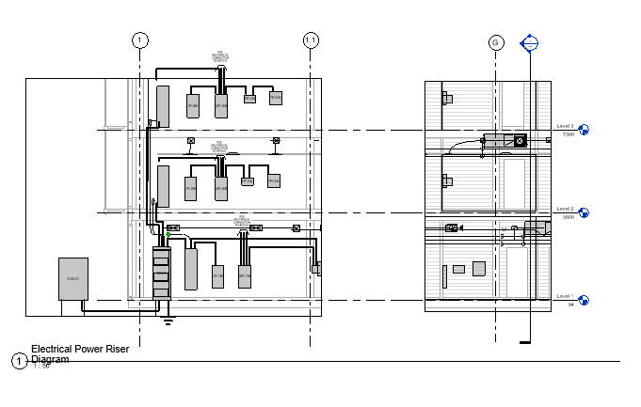
Why would you overlap views?
To compare or coordinate different aspects of the design
To show more detail in a single view
To compare design options

Slide 4
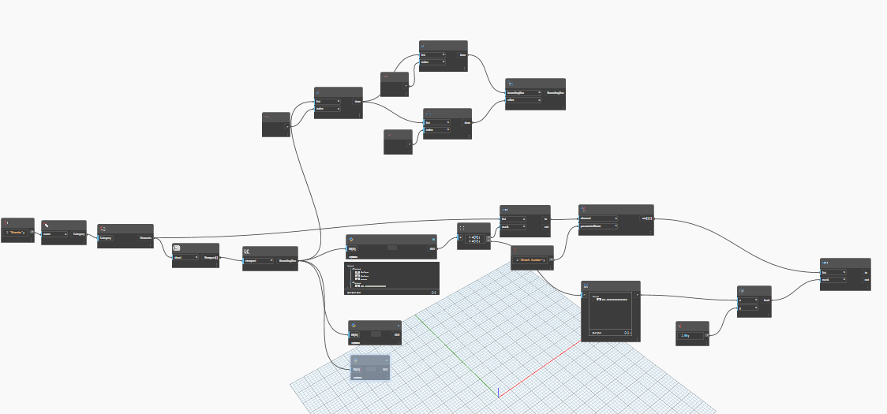
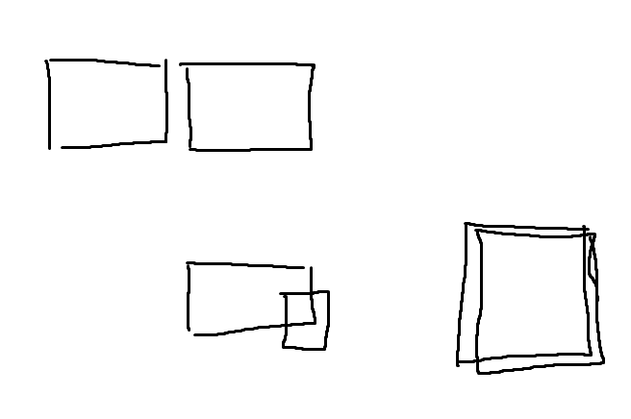
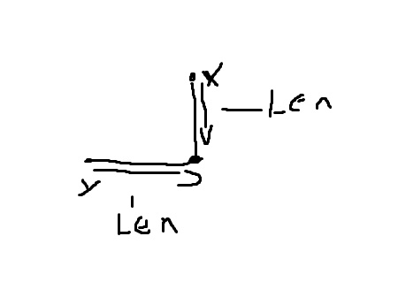
Find sheets with overlapping views

Slide 5
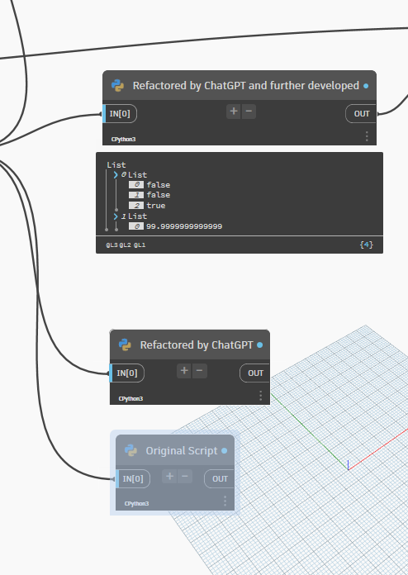
Find sheets with overlapping views

Slide 6
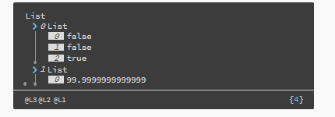
Find sheets with overlapping views

Slide 7
Find sheets with overlapping views

Slide 8
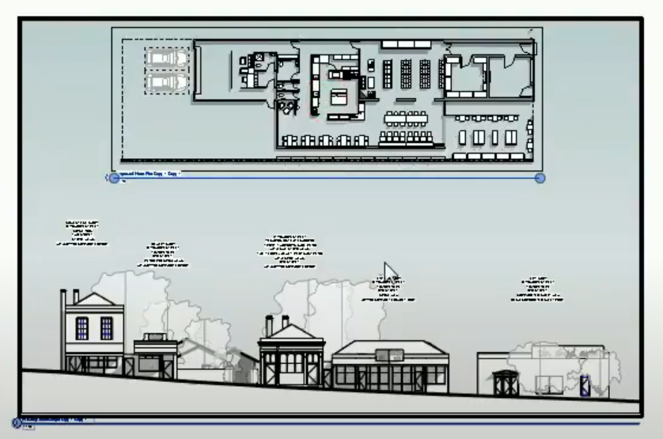
Resources
Revit OpEd: https://revitoped.blogspot.com/2005/02/overlaying-views-on-sheets.html
Real World Revit: https://revit.miraheze.org/wiki/Overlapping_Plans
View overlapping on sheet in Revit: https://youtu.be/B6hsfBnKPls
Bin He ‘s Revit Study Channel

Slide 9


Sub-title
https://discord.gg/kYDeYGZ

